Slide 1
linear regression model

Slide 2
linear regression model
We consider the modeling between the dependent and one independent variable.
When there is only one independent variable in the linear regression model, the model is generally termed as simple linear regression model.
When there are more than one independent variables in the model, then the linear model is termed as the multiple linear regression model.

Slide 3
Regression Modeling Steps
Define problem or question
Specify model
Collect data
Do descriptive data analysis
Estimate unknown parameters
Evaluate model
Use model for prediction

Slide 4
Goal
Develop a statistical model that can predict the values of a dependent (response) variable based upon the values of the independent (explanatory) variables.

Slide 5
Simple Regression
A statistical model that utilizes one quantitative independent variable “X” to predict the quantitative dependent variable “Y.”

Slide 6
Multiple Regression
A statistical model that utilizes two or more quantitative and qualitative explanatory variables (x₁,..., x_{p}) to predict a quantitative dependent variable Y.
Caution: have at least two or more quantitative explanatory variables (rule of thumb)

Slide 7
Linear regression
In correlation, the two variables are treated as equals. In regression, one variable is considered independent (=predictor) variable (X) and the other the dependent (=outcome) variable Y.

Slide 8
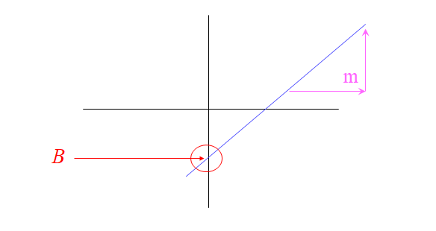
What is “Linear”?
Remember this:
Y=mX+B?

Slide 9
What’s Slope?
A slope of 2 means that every 1-unit change in X yields a 2-unit change in Y.

Slide 10
Prediction
If you know something about X, this knowledge helps you predict something about Y. (Sound familiar?…sound like conditional probabilities?)

Slide 11
Regression equation
Expected value of y at a given level of x=
where
E xi: represents the predicted response value for ith observation.
Alpha & Beta are regression coefficients and represent y-intercept and slope of regression line respectively.

Slide 12
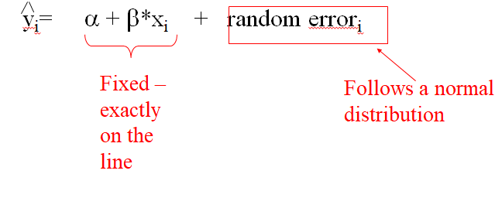
Predicted value for an individual

Slide 13
Assumptions (or the fine print)
Linear regression assumes that…
1. The relationship between X and Y is linear
2. Y is distributed normally at each value of X
3. The variance of Y at every value of X is the same (homogeneity of variances)
4. The observations are independent

Slide 14
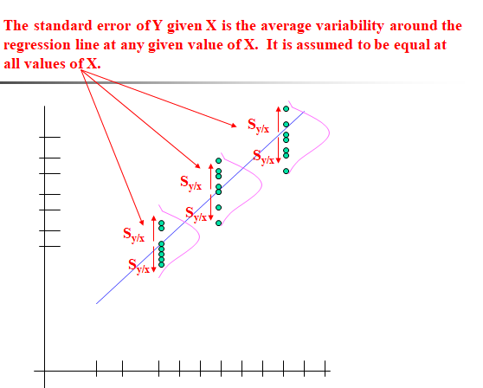

Slide 15
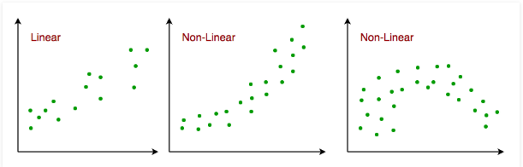

Slide 16
Applications:
1. Trend lines: A trend line represents the variation in some quantitative data with passage of time (like GDP, oil prices, etc.).
2. Economics: Linear regression is the predominant empirical tool in economics. For example, it is used to predict consumption spending, fixed investment spending, inventory investment, purchases of a country’s exports, spending on imports, the demand to hold liquid assets, labor demand, and labor supply.
3. Finance: Capital price asset model uses linear regression to analyze and quantify the systematic risks of an investment.
4. Biology: Linear regression is used to model causal relationships between parameters in biological systems.

